Slide 1

CalorieMate
By Team 3 - The Innovators

Slide 2
Agenda
Agenda
Team Member Roles and Responsibilities
Improvements from Professor Feedback
Project Description
Team Working Agreement
Personas
MVP
Technologies
Algorithms
Diagrams
Product Backlog
Sprint 3 Backlog
Metrics
Retrospective
Project Demo - Sprint 3
GitHub Link
Live Application Demo
Recap

Slide 3
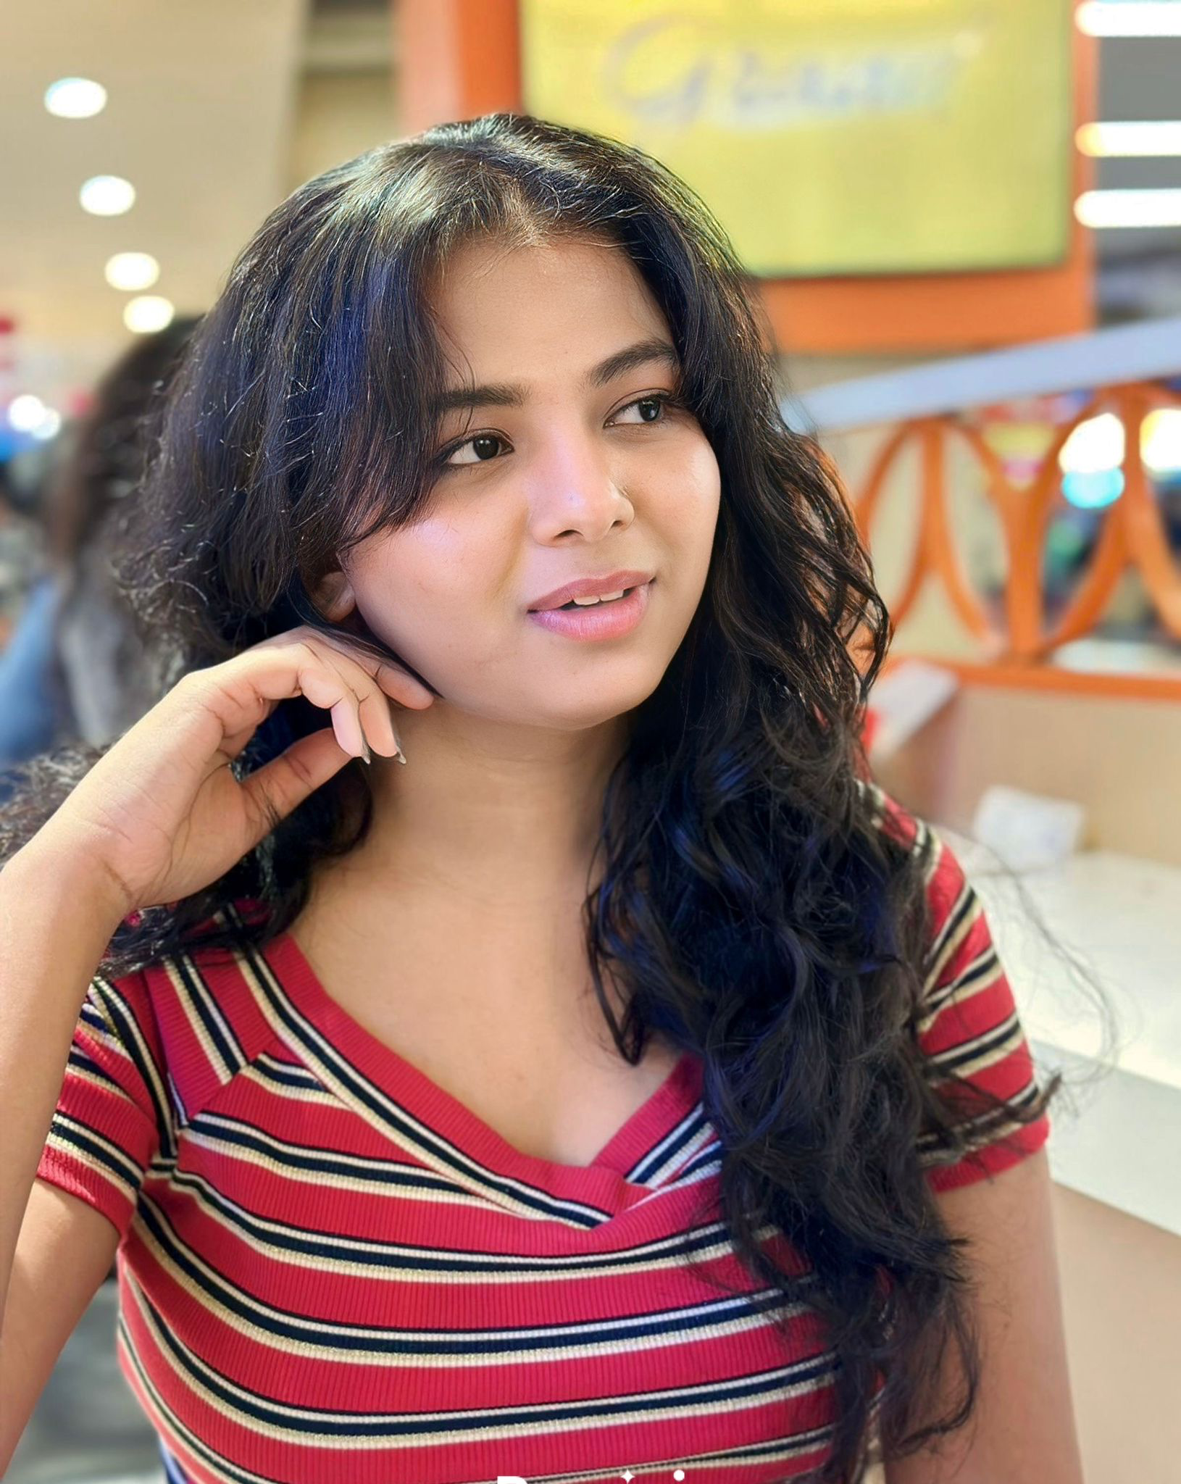


Team Member Roles and Responsibilities
Ranjitha Durgasi – Frontend Developer- Team Leader
Nikhitha Reddy Nallanagula – Frontend Developer
Harshitha Korapati Murali – Backend Developer

Slide 4

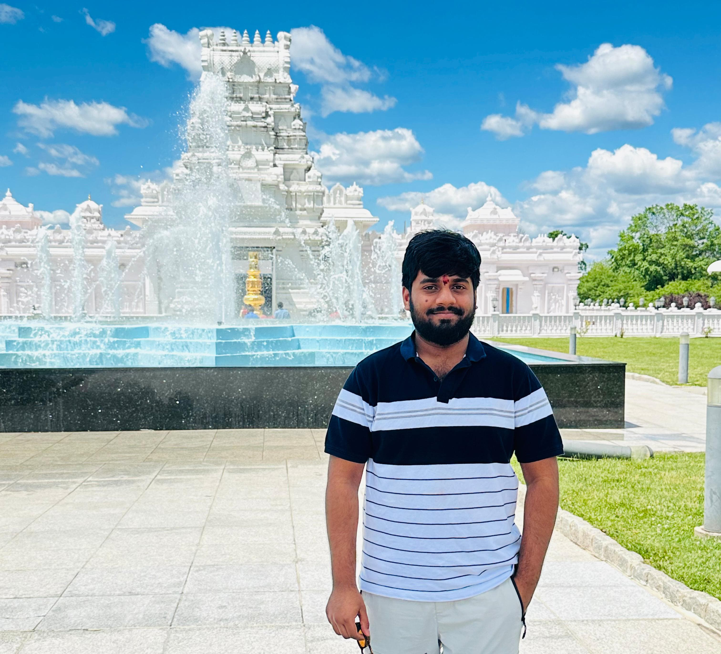
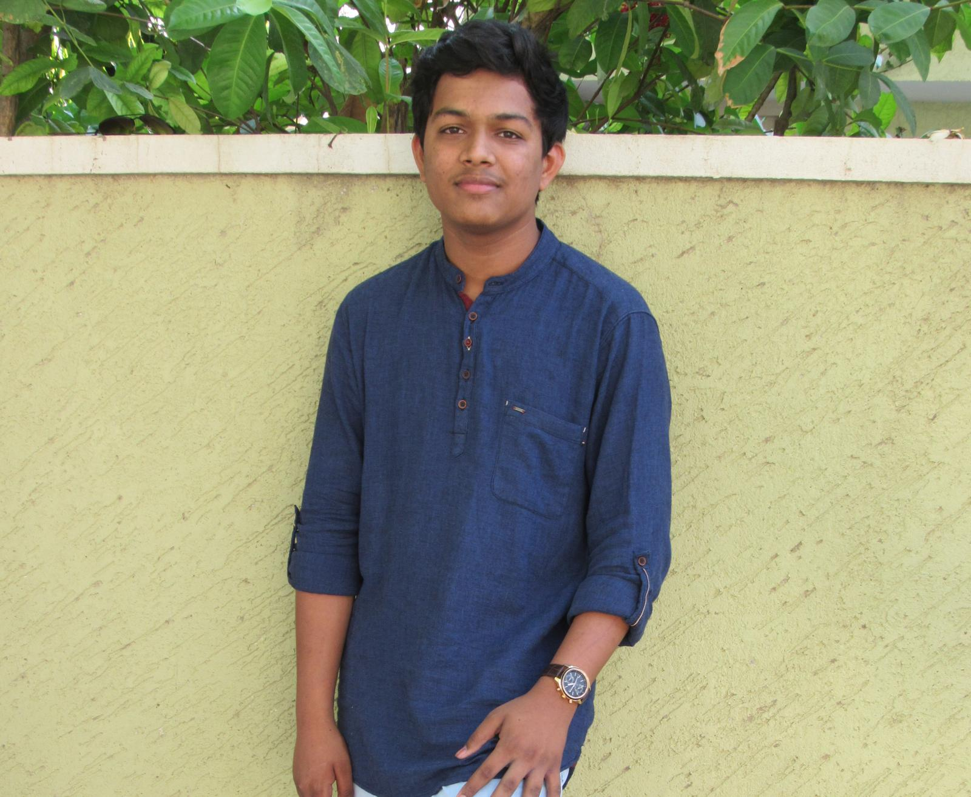
Team Member Roles and Responsibilities
Sai Bhargav Ram Koduru – Backend Developer
Saikumar Gone – Machine Learning Engineer- Scrum Master
Kariveda Vikranth Reddy – Machine Learning Engineer

Slide 5
Improvements
Retrospective: Share a collaborative link, introduce everyone, and ensure action items focus on real improvements.
Sprint Planning: Include team introductions, show total sprint load (Slide 41), and clearly reference user stories with roles/personas.
Demo Video: Skip “Hello Professor” and explain how the code works.
Slide Fixes: Add average value on Slide 36 and specify “As a user” with total points on Slide 34, Add Sprint Recap.
Burndown Chart: Explain it as a story of sprint progress and clarify what it shows about team performance.

Slide 6
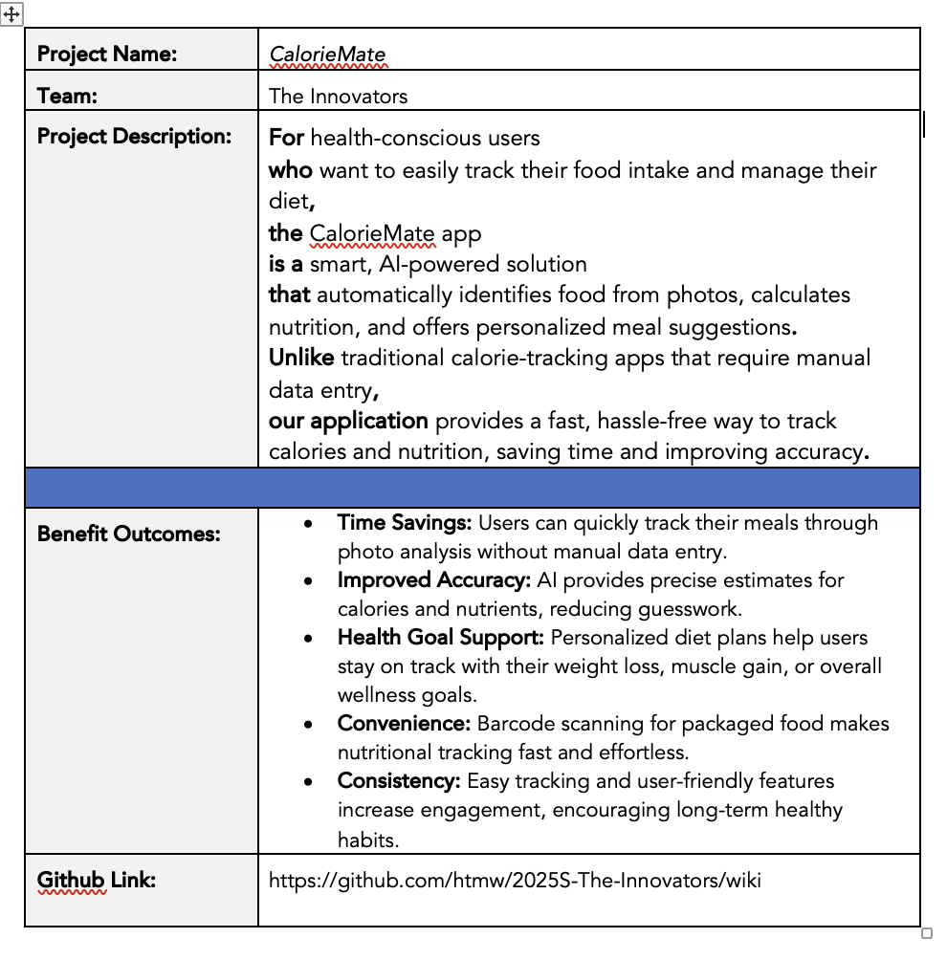
Project Description

Slide 7
Team Working Agreement
Communication: Lets make sure to share updates and have discussions on platforms like Slack. Make sure to have check ins, such, as weekly stand up meetings or sprint reviews to keep everyone on the same page and working together smoothly. Cooperation;
Team Meetings & Collaboration: To ensure effective meetings, the team should agree on key points, such as scheduling regular meetings twice a week at 6-8pm via virtual (zoom).Our main agenda is to make all team members work and make submissions on time. As a team we should help one another by sharing each other thoughts and make sure all perspectives are heard before deciding.
Roles and Responsibilities: Each team member has the task of finishing assignments based on their designated roles in frontend development, backend development, and machine learning. Coordinate with teams to seamlessly incorporate various functionalities.
Decision-Making: Decisions will be collaboratively reached in team gatherings. In situations where there are differences in opinions or views arise among us team members, we go for majority votes.
Deliverables: Each sprint should lead to producing the outcomes like presentations updates, to technical papers and wikis. Make sure to review and test all your work before submitting it for consideration.
Retrospectives: After each sprint is completed it's important to have a session to review the successes and areas for improvement as well as to outline specific steps, for the upcoming sprint.
Agreed by:
Ranjitha Durgasi
Nikhitha Reddy Nallanagula
Harshitha Korapati Murali
Sai Bhargav Ram Koduru
Saikumar Gone
Kariveda Vikranth Reddy

Slide 8

Persona
Sneha (Fitness Freak)
Age: 26
Occupation: Marketing Specialist
Goals: To build muscle and maintain a healthy diet.
Challenges: Finds it time-consuming to manually log every meal and calculate macros (proteins, carbs, fats).
How CalorieMate Helps: Sneha can take photos of her meals to instantly track nutrients, saving time and keeping her fitness plan on track.

Slide 9

Persona
Surya cook (Busy Professional)
Age: 35
Occupation: Software Engineer
Goals: To lose weight and adopt healthier eating habits.
Challenges: Limited time to research or record calorie information due to his demanding work schedule.
How CalorieMate Helps: The app’s photo recognition and barcode scanner allow cooking to quickly track meals, making calorie management fit seamlessly into his day.

Slide 10

Persona
Kruti Patel (Health-Conscious Parent)
Age: 30
Occupation: Doctor
Goals: To maintain a balanced diet and teach her family healthy eating habits.
Challenges: Difficulties estimating nutritional content of home-cooked meals.
How CalorieMate Helps: Kruti can easily track home-cooked meals using photo recognition and adjust portions to get accurate nutritional insights, helping her plan meals for the entire family.

Slide 11
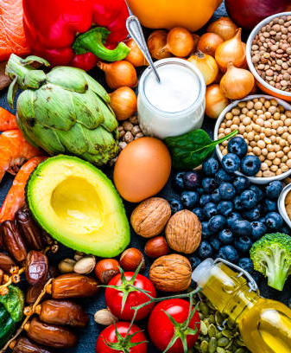
MVP
Food identification from photos using AI
Automatic calorie and nutrition calculation
Barcode scanning for packaged food
Daily calorie and nutrient tracking dashboard
Personalized meal suggestions based on user goals

Slide 12

Technologies
Frontend: Expo (React Native)
Used to build the mobile app for both Android and iOS platforms, ensuring a smooth and consistent user experience across devices.

Slide 13



Technologies
Backend: FastAPI, MongoDB, AWS
FastAPI: Manages API communication between the mobile app, machine learning models, and database.
MongoDB: Stores user data such as meals, nutritional logs, and preferences.
AWS: Provides cloud infrastructure for hosting the app, including APIs, databases, and machine learning services, ensuring scalability and reliability.

Slide 14


Technologies
Machine Learning: PyTorch, Hugging Face
PyTorch: Used to build and deploy AI models for food recognition and nutrition estimation.
Hugging Face: Supplies pre-trained vision-language models (VLM) to improve image recognition accuracy, reducing development time.

Slide 15
Algorithm
Our application utilizes some important algorithms to automate and enhance the process of calorie and nutrition tracking. The food image recognition algorithm employs the InstructBLIP model to process meal images, identify food items, and recognize them with high accuracy. After recognizing the foods, a nutritional estimation algorithm estimates the calories, proteins, carbohydrates, and fats based on nutritional databases and approximate portion sizes.

Slide 16
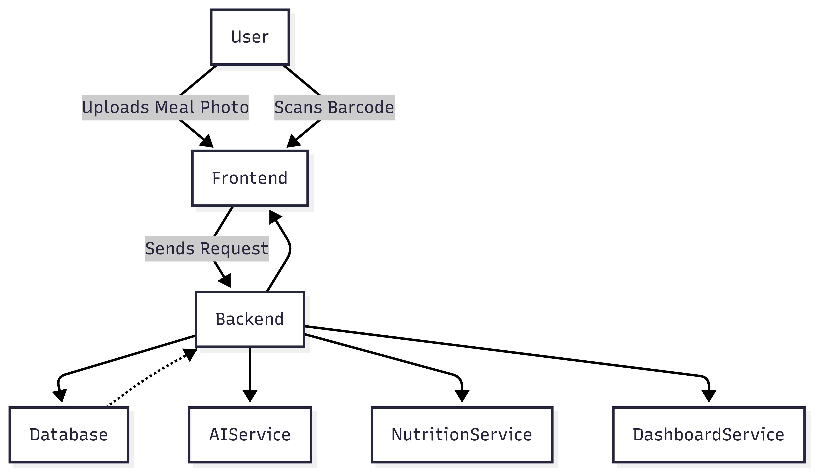
Architecture Diagram

Slide 17
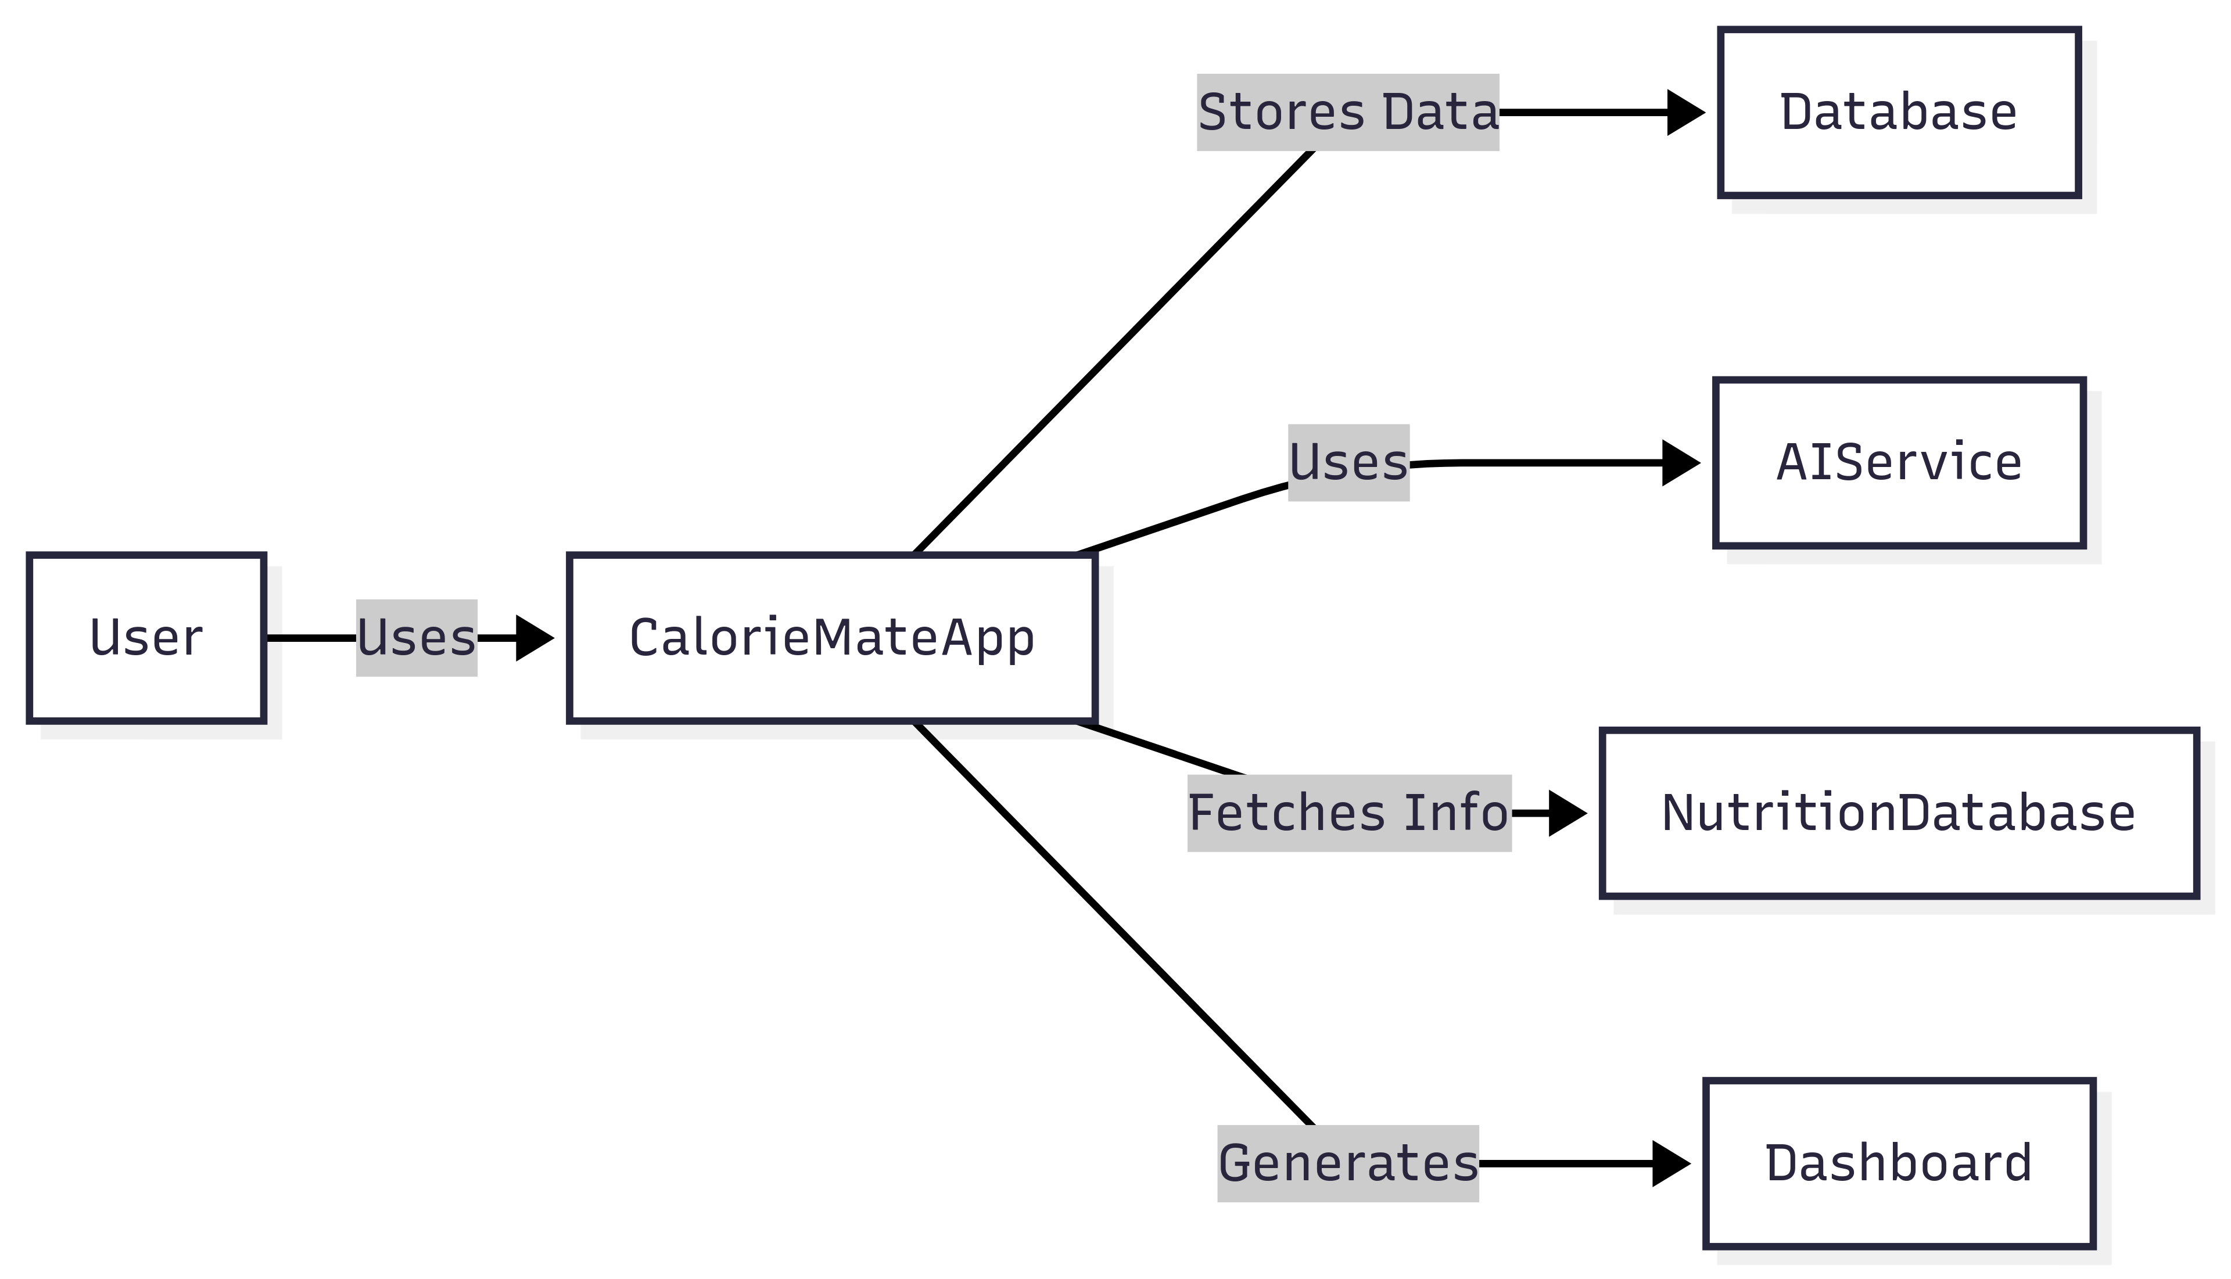
Context diagram

Slide 18
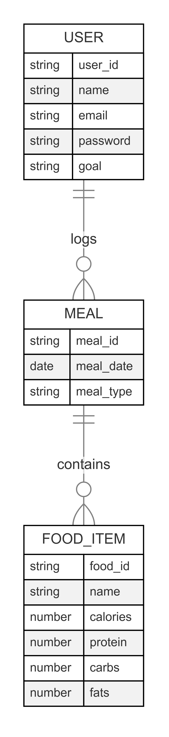
ER Diagram

Slide 19
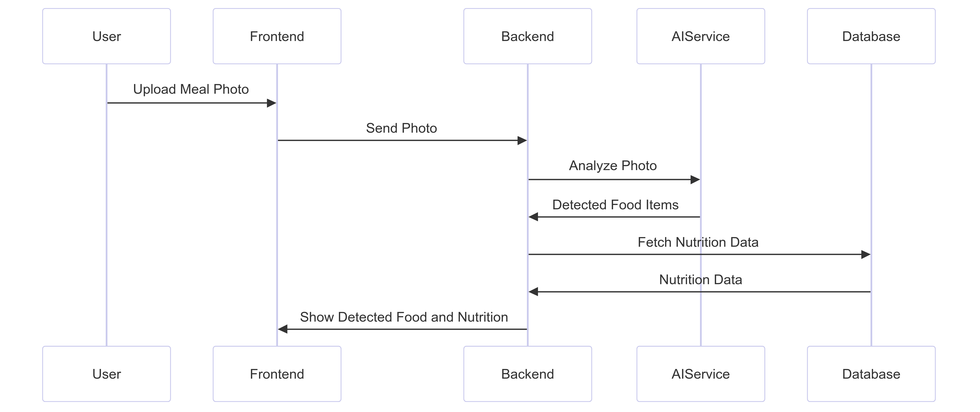
Sequence Diagram

Slide 20
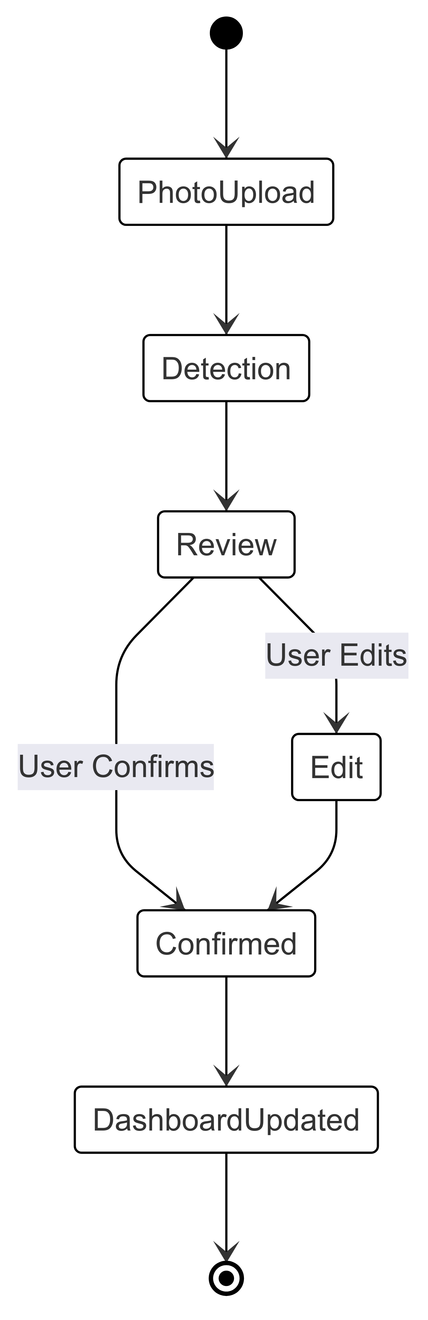
State Diagram

Slide 21
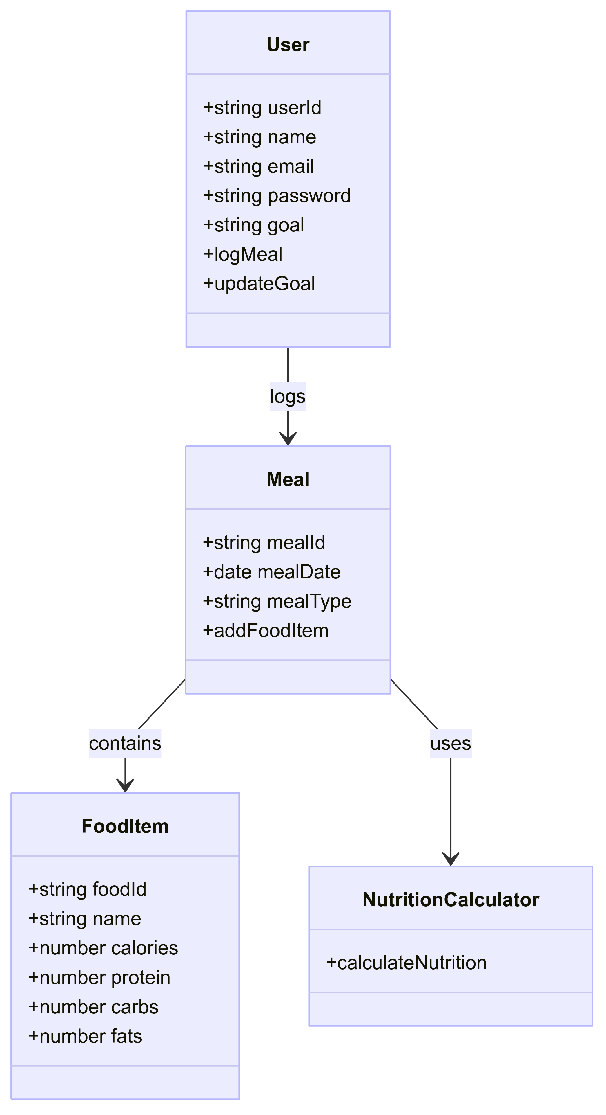
Class Diagram

Slide 22
Recap Sprint 2
In Sprint 2, we implemented barcode scanning for quick meal logging, added goal setting to personalize calorie targets, and enhanced the dashboard with macro breakdowns. Users can now edit or delete past meals, and view full meal history by date. All planned features were completed, achieving a 100% completion rate.

Slide 23
Product Backlog
ID | User Stories | Acceptance Criteria | Feature | Story Points | Sprint
US1 | As a Health-Conscious Individual, I want to create an account and log in so that my data is saved. | User can sign up and log inError shown for wrong credentialsLogout works | Authentication | 3 | 1
US2 | As a Fitness Enthusiast, I want to upload a meal photo or take an image from the camera so that I can manually enter my food details. | Users can upload an image or take a photo.Users manually input food items.Error shown if no items are added. | Photo Upload | 5 | 1
US3 | As a Nutrition Tracker, I want to manually enter food items so that I can track my meals. | Users can enter food items manually.Users can input portion sizes.Data is saved to the meal log after confirmation. | Food Entry | 3 | 1
US4 | As a Meal Logger, I want to edit food items so that my meal log is accurate. | Users can modify the food name and portion size. Changes are saved automatically to the meal log. | Manual Food Editing | 3 | 1
US5 | As a Health Monitor, I want to see a daily dashboard so that I can track my calories and nutrients. | Dashboard shows calories consumed, remaining budgetMacro breakdown shown | Dashboard | 3 | 1

Slide 24
Product Backlog
ID | User Stories | Acceptance Criteria | Feature | Story Points | Sprint
TS1 | Set up user authentication backend | Database created for usersSignup, login, logout APIs readyPasswords securely stored | Authentication Backend | 3 | 1
TS2 | Set up photo upload UI | Users can upload images from the gallery or take a photo. | Photo Upload | 5 | 1
TS3 | Build UI for manual food entry | Users can enter food names and portion sizes manually. | Food Entry | 3 | 1
TS4 | Build UI for food editing | Users can edit food items and portion sizes. | Manual Food Editing | 3 | 1
TS5 | Build daily dashboard UI & backend | Dashboard reads meal logCalculates totalsShows simple charts | Dashboard Backend + UI | 3 | 1

Slide 25
Product Backlog
ID | User Stories | Acceptance Criteria | Feature | Story Points | Sprint
US6 | As a Busy Professional, I want to scan barcodes to log packaged food so that I can log faster. | Barcode scanning worksFinds product in databaseAdds to meal log | Barcode Scanning | 5 | 2
US7 | As a Fitness Enthusiast, I want to set my health goal so that my calorie target is personalized. | Goal can be setCalorie target updatesGoal can be changed later | Goal Setting | 2 | 2
US8 | As a Health Monitor, I want to see my daily macro breakdown so that I know if my meals are balanced. | Dashboard shows grams & percentages for macrosUpdates after each meal log | Dashboard | 2 | 2
US9 | As a Meal Logger, I want to edit or delete past meal entries so that I can fix mistakes. | Past meals listedEdit or delete worksDashboard recalculates after change | Meal Log Management | 3 | 2
US10 | As a Nutrition Tracker, I want to view my full meal history so that I can review my past eating habits. | All past meals listed by dateClicking shows full details | Meal History | 2 | 2

Slide 26
Product Backlog
ID | User Stories | Acceptance Criteria | Feature | Story Points | Sprint
TS6 | Build barcode scanning backend and food database | Food database includes packaged foodsBarcode scanning works on mobileAdds directly to log | Barcode Scanner Backend | 5 | 2
TS7 | Set up goal setting feature | Goal stored in user profileGoal adjusts calorie target in dashboard | Goal Backend | 2 | 2
TS8 | Add macro breakdown logic to dashboard | Dashboard calculates macros from mealsUpdates automatically | Dashboard Logic | 2 | 2
TS9 | Build meal history with edit/delete | Meal logs stored by dateEdit and delete APIs workDashboard updates after changes | Meal Log Backend | 3 | 2
TS10 | Build full meal history page | Meals listed by dateClicking opens meal details | Meal History UI | 2 | 2

Slide 27
Product Backlog
ID | User Stories | Acceptance Criteria | Feature | Story Points | Sprint
US11 | As a fitness freak, I want to see calories and nutrients after entering my meal so that I know what I’m eating. | Users enter food items manually.Calories, protein, carbs, and fats are displayed.Data is saved to the meal log. | Calorie & Nutrition Display | 5 | 3
US12 | As a Health conscious parent, I want to see a weekly progress report so that I can track my long-term trends. | Weekly calories graph shownWeekly macro average shown | Progress Report | 3 | 3
US13 | As a gym addict, I want a settings page to manage my preferences so that I can customize the app. | User can set units (metric/imperial)User can change goalChanges saved immediately | Settings | 2 | 3
TS11 | Build AI-based calorie & nutrition calculation | Users enter food items manually.AI calculates calories, protein, carbs, and fats.Data is saved to the meal log. | AI-Based Nutrition Calculation | 5 | 3
TS12 | Build weekly progress backend & UI | Backend calculates 7-day summaryUI shows graph & macro summary | Progress Report | 3 | 3

Slide 28
Product Backlog
ID | User Stories | Acceptance Criteria | Feature | Story Points | Sprint
TS13 | Build settings page backend & UI | Preferences saved per userChanges reflected in dashboardSupports units and goals | Settings Backend + UI | 2 | 3

Slide 29
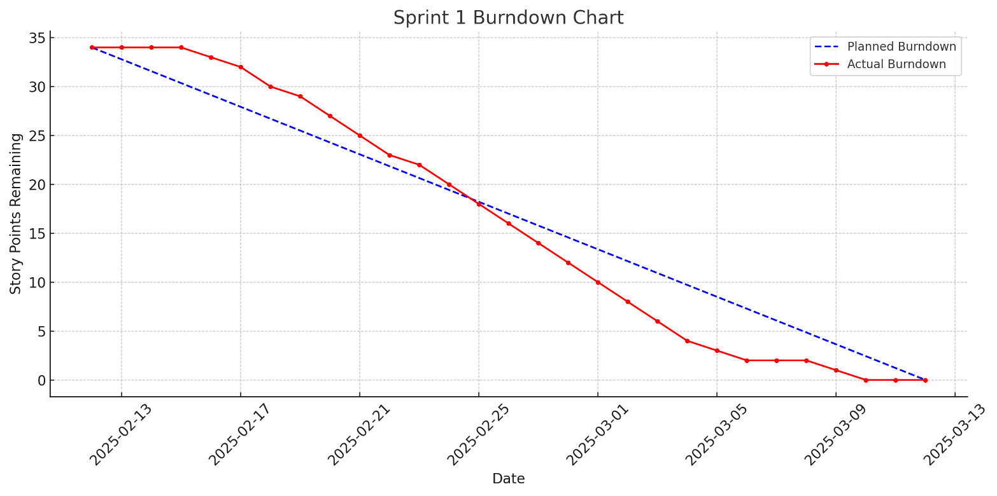
Sprint 1 Summary
Delivered user authentication, meal photo upload, manual food entry, food editing, and daily dashboard. A total of 34 story points were committed and fully completed.

Slide 30
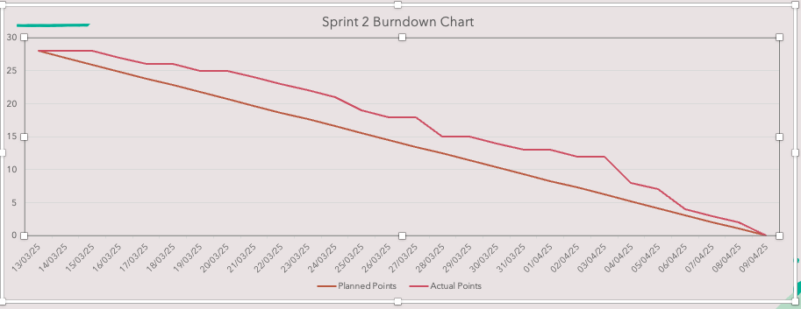
Sprint 2 Summary
Focused on barcode scanning, personalized goal setting, dashboard macro breakdown, meal log management (edit/delete), and full meal history view. All 28 story points were completed as planned.

Slide 31
Sprint 3 Backlog
ID | User Stories | Acceptance Criteria | Feature | Story Points | Sprint
US11 | As a Fitness freak, I want to see calories and nutrients after entering my meal so that I know what I’m eating. | Users enter food items manually.Calories, protein, carbs, and fats are displayed.Data is saved to the meal log. | Calorie & Nutrition Display | 5 | 3
US12 | As a health conscious parent, I want to see a weekly progress report so that I can track my long-term trends. | Weekly calories graph shownWeekly macro average shown | Progress Report | 3 | 3
US13 | As a gym addict, I want a settings page to manage my preferences so that I can customize the app. | User can set units (metric/imperial)User can change goalChanges saved immediately | Settings | 2 | 3
TS11 | Build AI-based calorie & nutrition calculation | Users enter food items manually.AI calculates calories, protein, carbs, and fats.Data is saved to the meal log. | AI-Based Nutrition Calculation | 5 | 3
TS12 | Build weekly progress backend & UI | Backend calculates 7-day summaryUI shows graph & macro summary | Progress Report | 3 | 3

Slide 32
Sprint 3 Backlog
ID | User Stories | Acceptance Criteria | Feature | Story Points | Sprint
TS13 | Build settings page backend & UI | Preferences saved per userChanges reflected in dashboardSupports units and goals | Settings Backend + UI | 2 | 3

Slide 33
Test Cases
US ID | Test Case ID | Test Case Description | Steps to Execute | Expected Result | Result (Pass/Fail)
US11 | TC11.1 | Enter meal manually and view nutrition | 1. Open food entry screen2. Input food name and portion3. Save meal | Calories and macros (protein, carbs, fats) are shown | Pass
US11 | TC11.2 | Ensure nutrition data is saved | 1. Enter and save food2. Open meal log3. View saved item | Nutrition info is stored and shown correctly | Pass
US12 | TC12.1 | View weekly calories chart | 1. Log meals for 7 days2. Open weekly progress screen3. Review graph | Weekly calories graph is displayed | Pass
US12 | TC12.2 | Check weekly macro average | 1. Log meals with macros2. Open progress screen3. Review summary | Weekly macro average is shown (protein, carbs, fats) | Pass

Slide 34
Test Cases
US ID | Test Case ID | Test Case Description | Steps to Execute | Expected Result | Result (Pass/Fail)
US13 | TC13.1 | Change unit preference | 1. Go to settings2. Change unit from metric to imperial3. Save and go to dashboard | Dashboard reflects new unit preference | Pass
US13 | TC13.2 | Update health goal | 1. Go to settings2. Change goal (e.g., weight loss to maintenance)3. Save and check dashboard | Calorie target updates accordingly | Pass
US13 | TC13.3 | Save preferences persistently | 1. Change settings2. Log out3. Log back in and open settings | Changes are saved and persist between sessions | Pass

Slide 35
Completed Stories Sprint 3
Story ID | Story Description | Story Points
US11 | As a fitness freak, I want to see calories and nutrients after entering my meal so that I know what I’m eating. | 5
US12 | As a health conscious parent, I want to see a weekly progress report so that I can track my long-term trends. | 3
US13 | As a gym addict, I want a settings page to manage my preferences so that I can customize the app. | 2
TS11 | Build AI-based calorie & nutrition calculation | 5
TS12 | Build weekly progress backend & UI | 3
TS13 | Build settings page backend & UI | 2
Total Points: 20

Slide 36
Team Velocity Sprint 3
Committed: 20 story points
Completed: 20 story points
Velocity: 20 story points

Slide 37
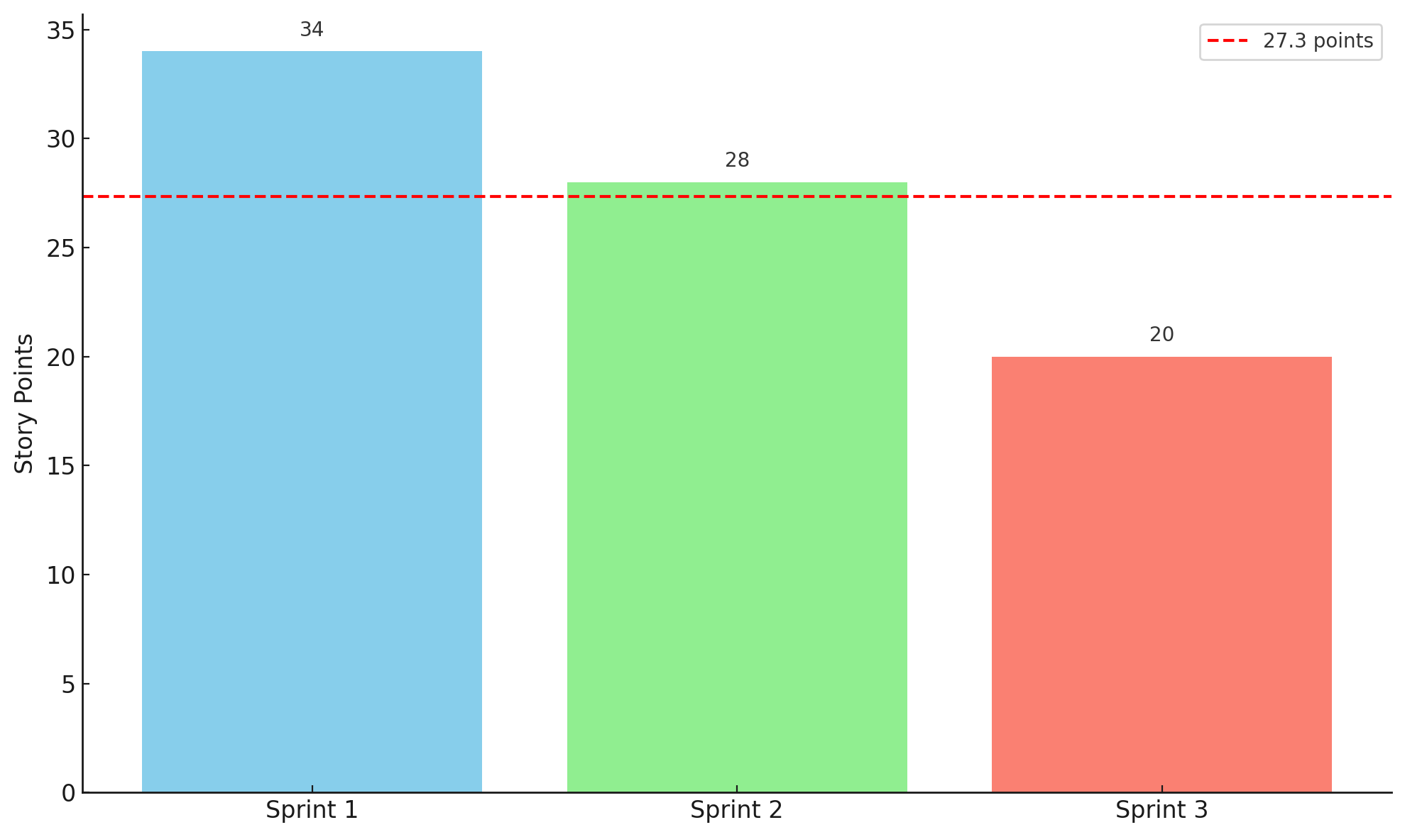
Historical Team Velocity

Slide 38
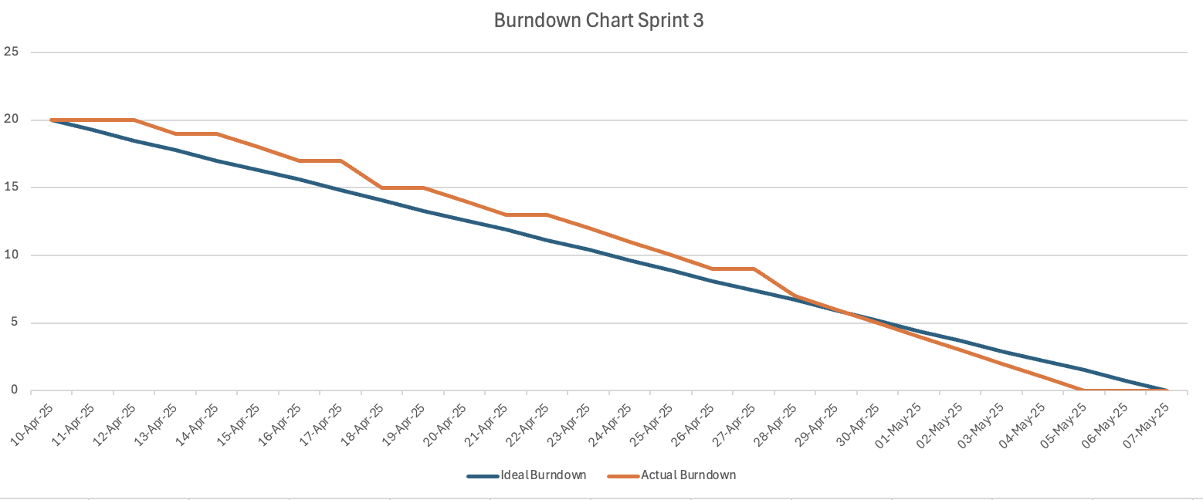
Burndown Chart

Slide 39
Completed/Committed Ratio
Sprint | Committed | Completed | Ratio
Sprint 1 | 34 | 34 | 100%
Sprint 2 | 28 | 28 | 100%
Sprint 3 | 20 | 20 | 100%
Average Completed/Committed Ratio (Sprint 1,2,3) (100% + 100% + 100%) / 3 = 100%

Slide 40
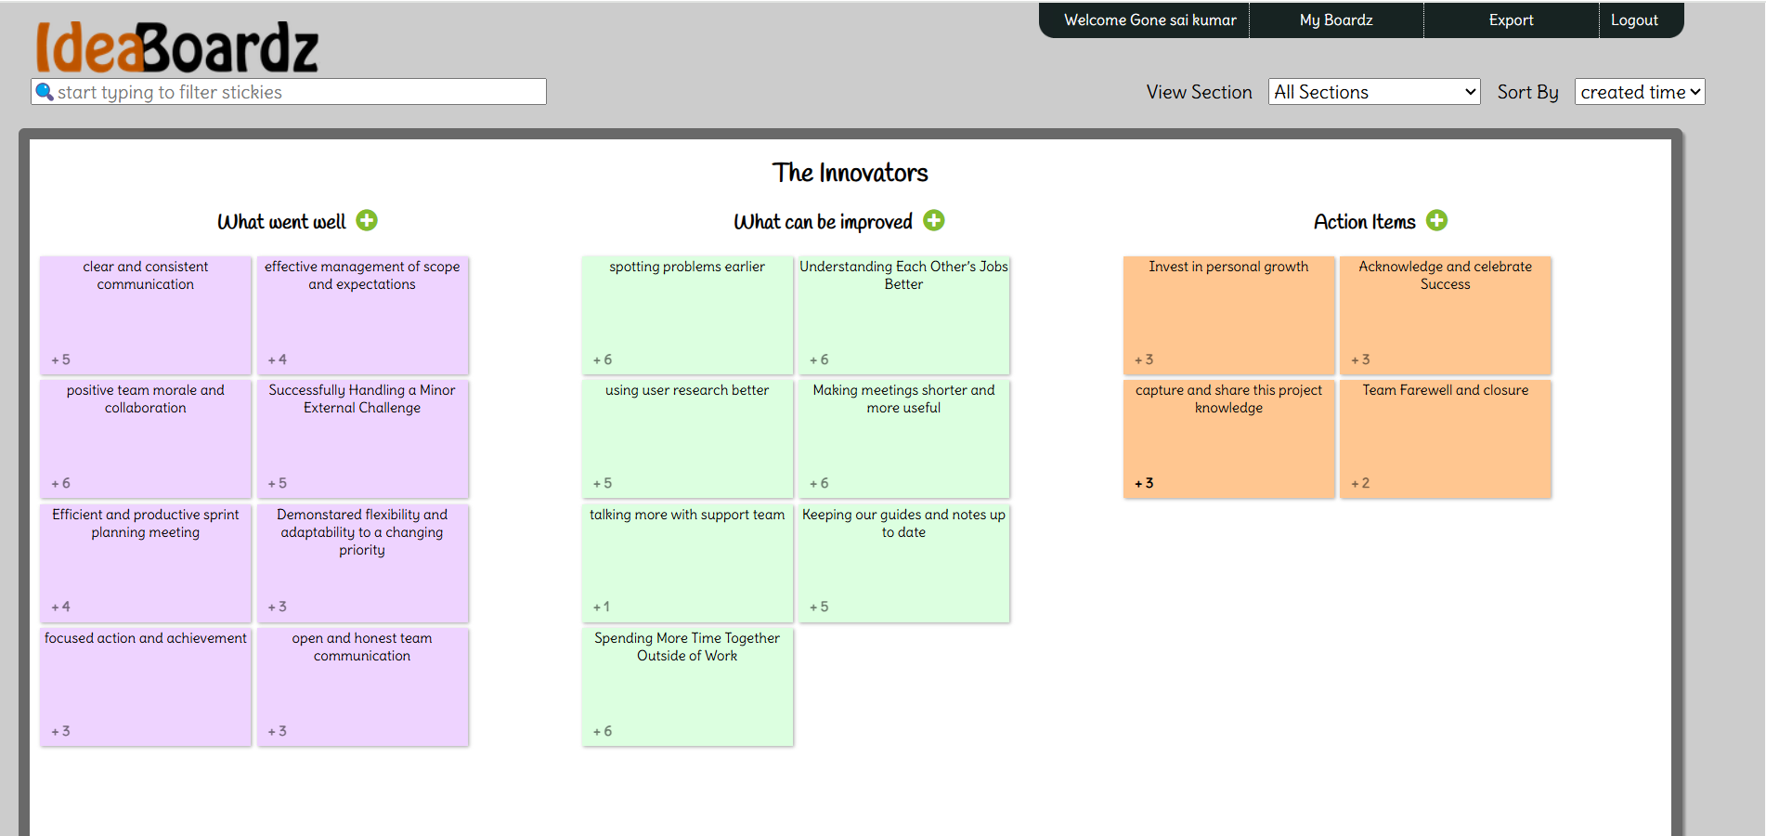
Retrospective

Slide 41
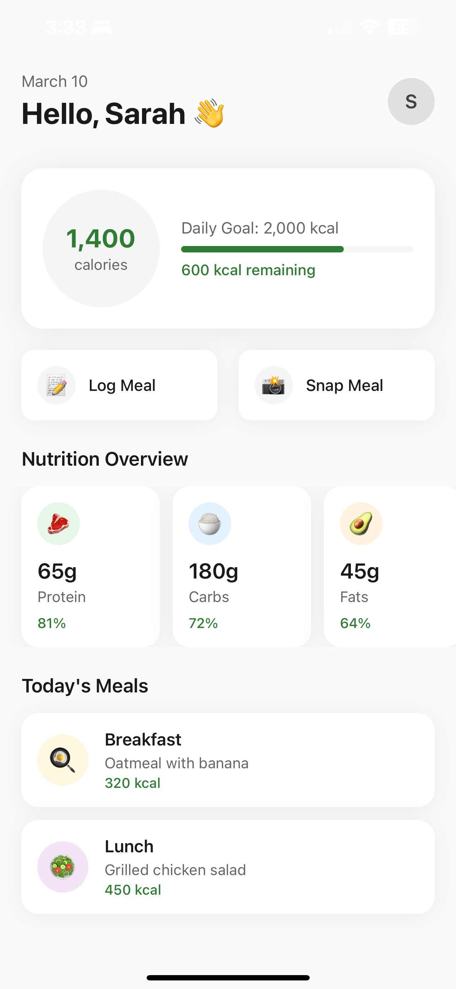
Application Screenshots

Slide 42
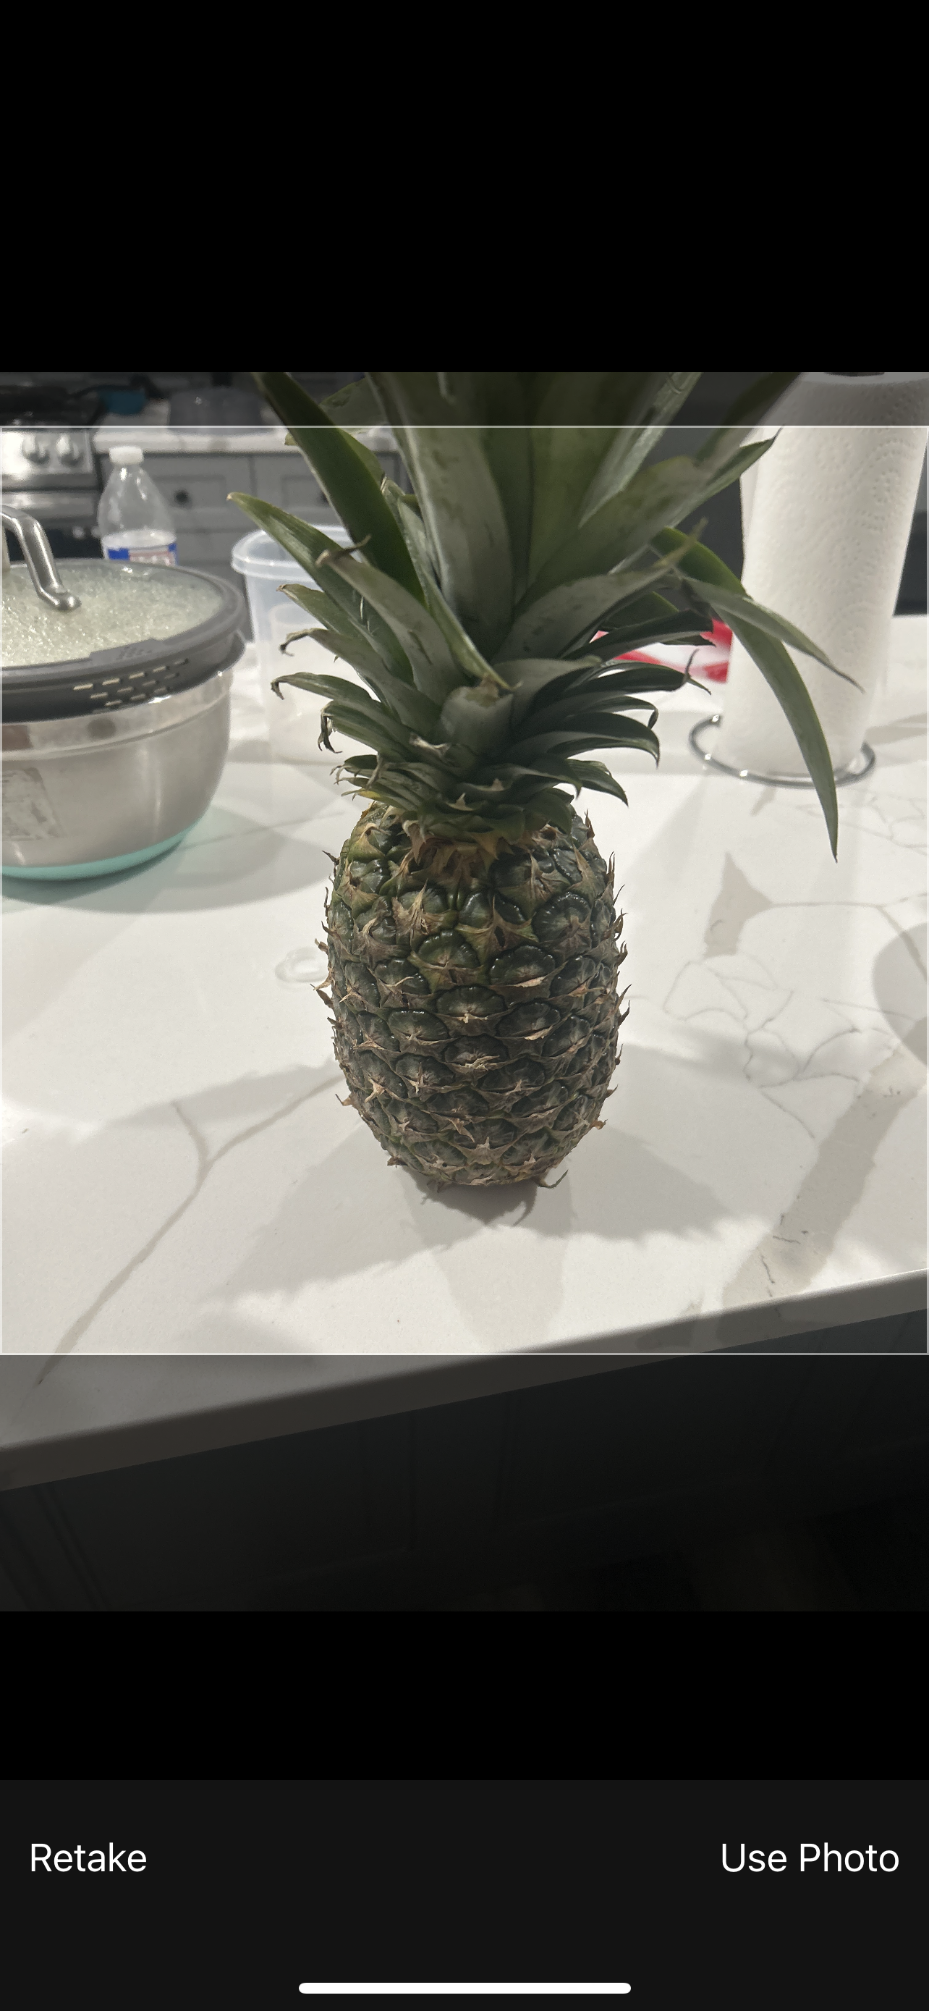
Application Screenshots

Slide 43
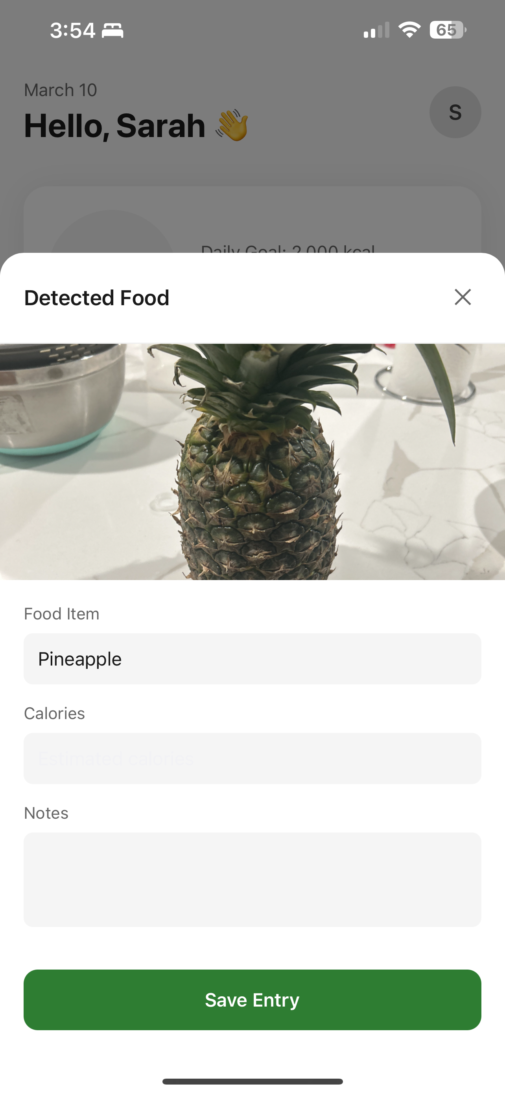
Application Screenshots

Slide 44
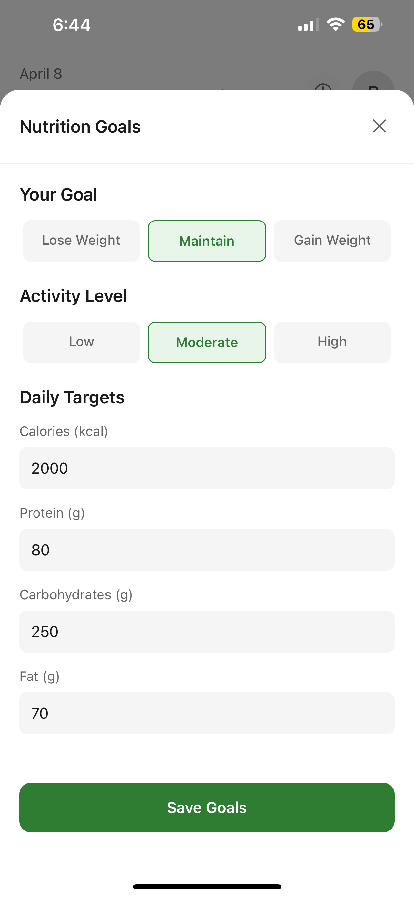
Application Screenshots

Slide 45
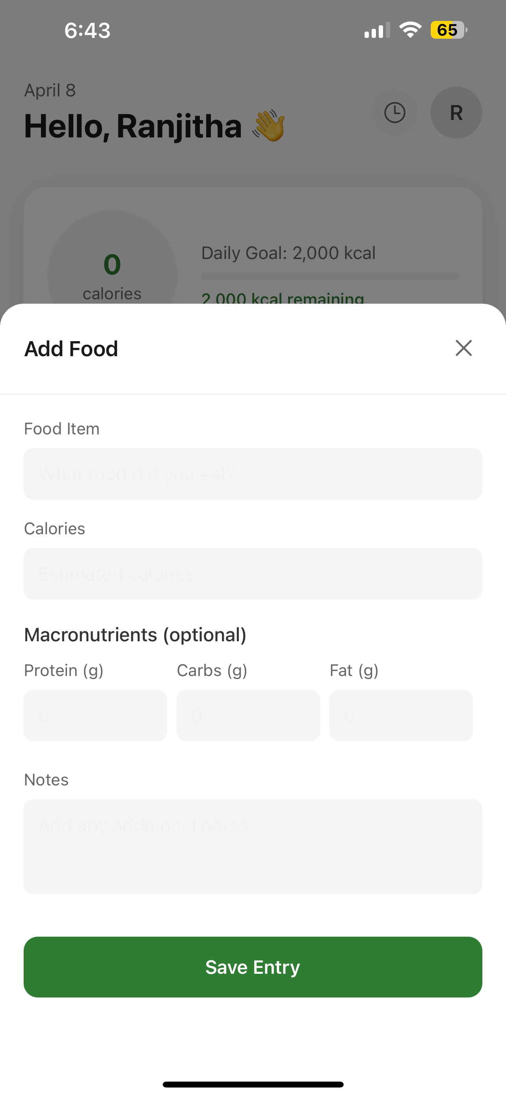
Application Screenshots

Slide 46
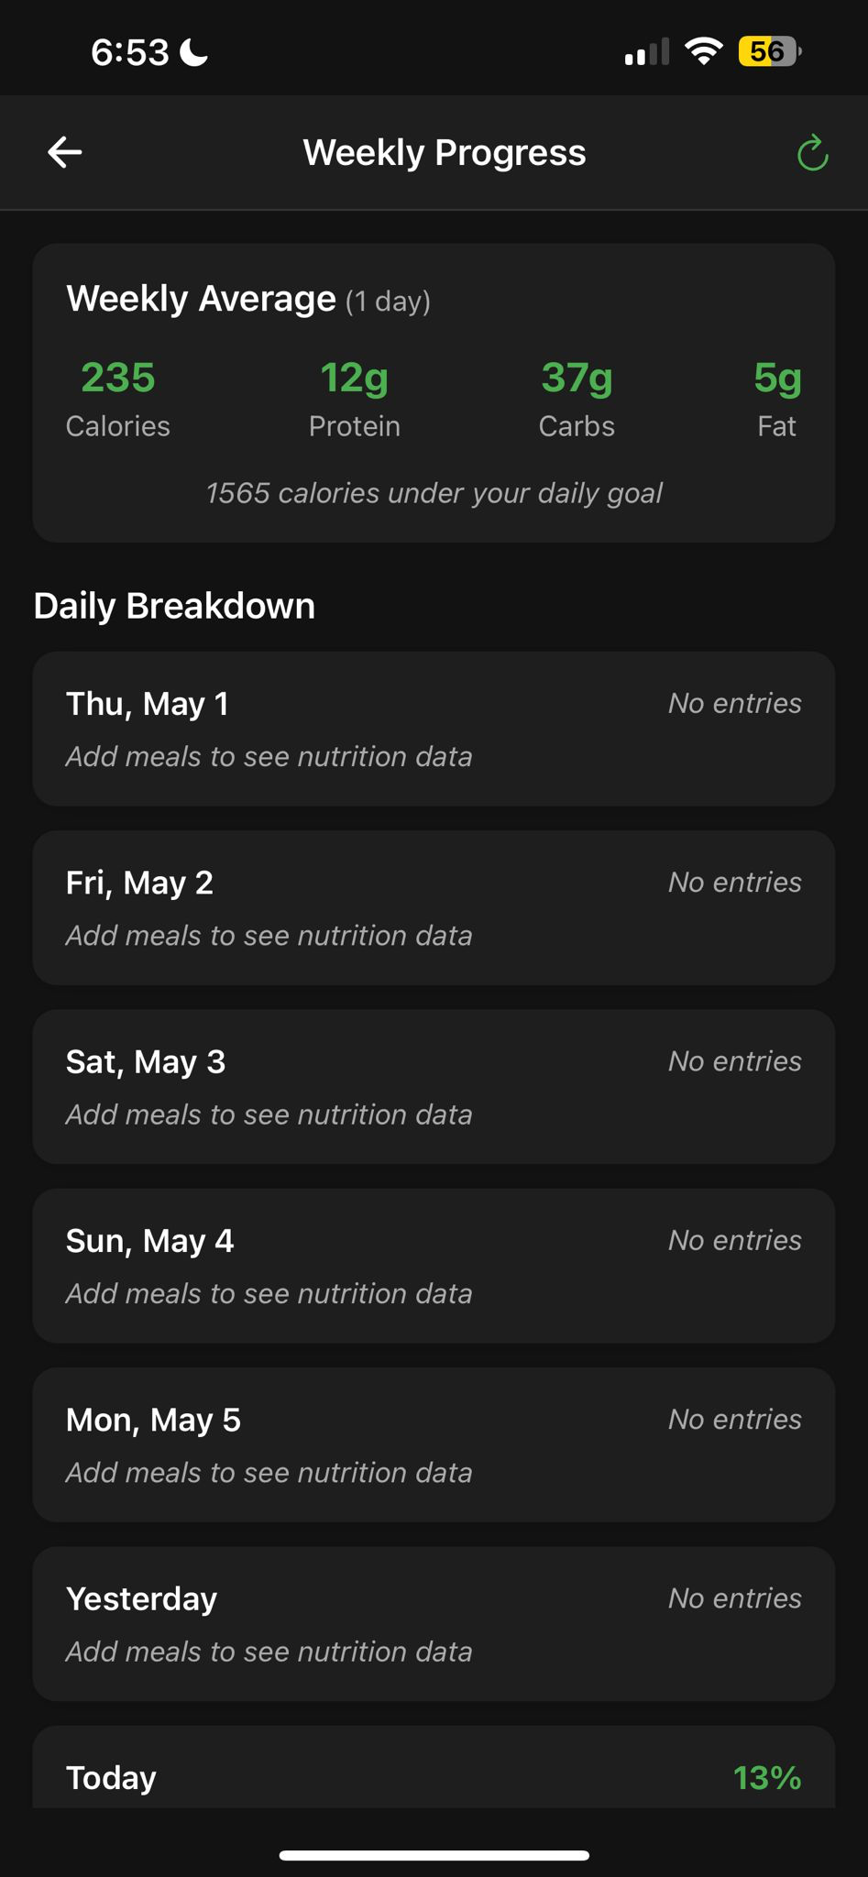
Application Screenshots

Slide 47
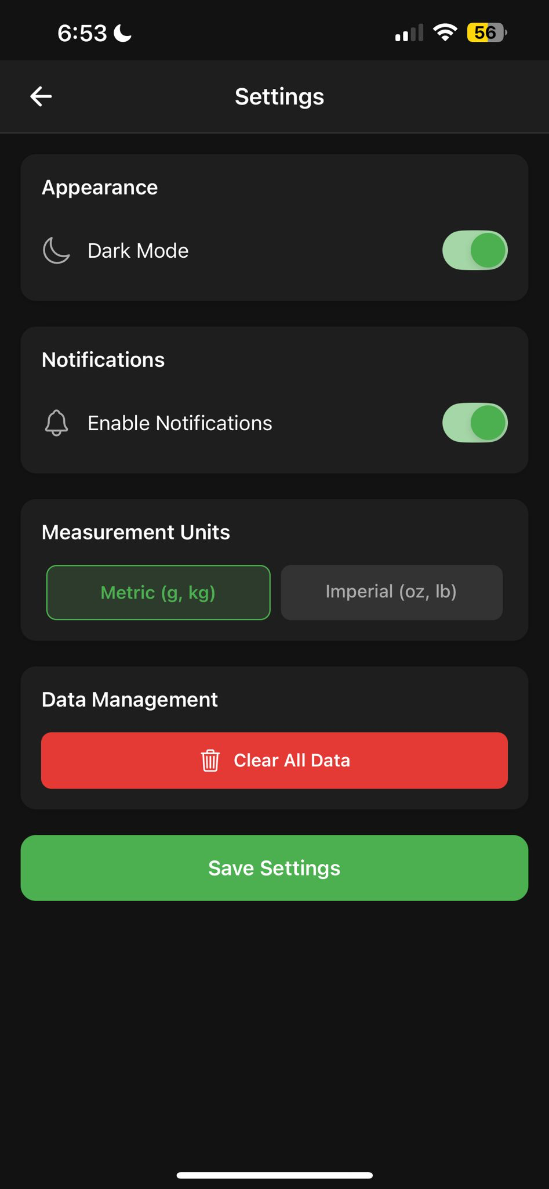
Application Screenshots

Slide 48
API
# Get all foods
$ curl http://localhost:3000/api/foods
{ "success": true, "data": [ "apple", "banana", "orange", "strawberry", "blueberry", "watermelon", "grape", "pineapple", "mango", "avocado", "carrot", "broccoli", "spinach", "potato", "tomato", "chicken breast", "salmon", "rice", "bread", "egg" ] }

Slide 49
API
# Get a specific food (apple)
$ curl http://localhost:3000/api/foods/apple
{ "success": true, "data": { "food": "apple", "calories": 52, "unit": "per 100g" } }

Slide 50
Wikipage Link
https://github.com/htmw/2025S-The-Innovators/wiki

Slide 51
Live Demo

